Slide 1

Scope Brief – ICM Interface PoC
Prudential Plc.,
26th Nov 2019

Slide 2
Prudential Plc : ICM Interface PoC
Purpose:
Prudential Plc is based out of London and was heading the group and known as Group Head Office (GHO). After separation from M&G, Prudential GHO does not sell any product in UK market. Only essential functions required to meet regulatory obligations in UK are supported out of GHO, for example Financial consolidation & Reporting, Solvency Reporting and key Risk Governance functions. TCS is the primary IT partner in Prudential GHO since Oct 2019 and provides end to end ADM and Infrastructure services with the team size of 100+
Under organization wide Finance & Actuarial Transformation initiatives (Future Finance Programme), Prudential are looking to improve and enhance various business processes. As part of the re-engineering, user interfaces are required for various processes. One of the items considered under this initiative is to replace the existing custom-built web interface Internal Capital Model (ICM) for managing inputs to the calculation engine and the outputs are processed for generating Solvency Reports in GHO. The application is bespoke and has been built and managed by Cleversoft (Second Floor). The system has evolved over the past decade and it has become expensive and time consuming to maintain and make changes to the system. The business logic is built on Java Spring Framework and database is SQL.
Current ask from Pru is to go back with a proposal to replace the current application with a technology solution that’s easy to maintain, that gives better time to market and allows them to utilise the solution across other Geos / business processes.
Competition: Deloitte, Microsoft

Slide 3
PoC Scope and Critical Success Factors
To build and demonstrate a prototype, using the ICM interface as template as it is well documented and the workflows are well understood within Pru. There are about 10 tabs in ICM Web Interface and out of which only 4 tabs are considered for PoC Scope as below:
Entity Structure
Lite Models
Aggregation Rules
Entity Sets
The following simplifications are proposed:
No back-end calculations need to be implemented.
Complex scheduling and running is not in scope
Do not implement the RAFM project section, this is for reference as the information is required in the lite model and aggregation rule section. It is included in the section for completeness to showcase the overall business use case
Success Criteria:
Developing a prototype that showcases the behaviour of a limited number of current ICM system workflows
The solution should be easy to maintain internally by Prudential staff. Please state assumptions on the support model and skillset of any support and development team.
It should be easy implement changes without the involvement of a set of professional developers
The release process should be well defined
Inputs Shared: ICM User Manual, Business Process Documents and Input files used in ICM

Slide 4
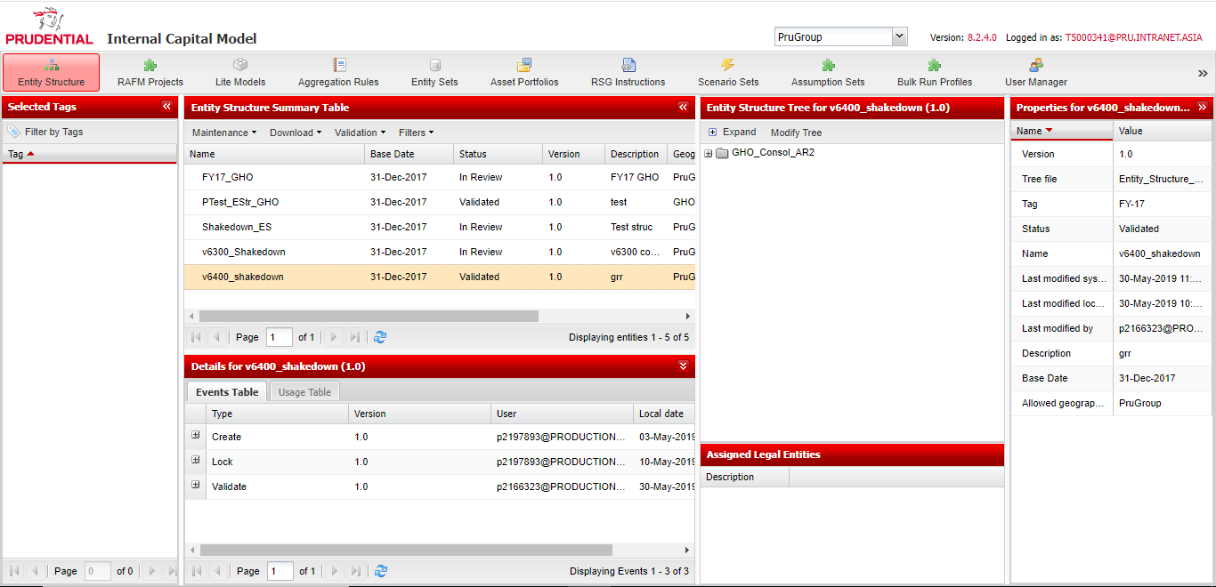
ICM Screen
ICM screen for reference as below and the template/workflows to be mirrored as its well conversed within Pru user base.
PoC Scope

Slide 5
Key tabs and PoC Scope
The ICM interface is a web-based interface with up to 10 tabs available to a user. The number of tabs visible to any user is defined by the access permissions based on the user’s role. Alongside tabs, users will also be restricted to views of data according to their geographical permission unless specific components have been shared with them
Tab name | Description | Users | PoC Scope? | No of use cases
RAFM projects | Allows the user to create and maintain Base Engines, Standard ICM RAFM Projects and Merged ICM RAFM Projects Must be created prior to creation of any dependent component | Selected users from GHO Risk Modelling Team, BUs
Entity structure | - Used for uploading the structure of the BU or Group - Can be created at any time prior to the creation of the entity set | BUs | Yes | 23
Lite models | - Allows the user to create their lite models on the interface by uploading required components - Also includes a bulk upload option- Can be created at any time prior to the creation of the entity set and the associated ICM RAFM standard project | BUs | Yes | 16
Aggregation rules | - Allows the user to create their aggregation rules by uploading required components - Also includes a bulk option - Can be created at any time prior to the creation of the entity set and the associated ICM RAFM standard project | BUs | Yes | 15
Entity sets | - Combines the entity structure, lite models and aggregation rules into one component ready for use in an assumption set Includes a bulk validation option - Must be created after its constituent components but prior to the creation of the assumption set | BUs | Yes | 14
RSG Instructions | - Allows the user to upload translator data and join translator data in a scenario assumption set. This function replaces the need to manually upload files. | GHO RSG team, BUs
Scenario sets | - Uses the Scenario Assumption Set attached to the interface to generate real time output for use by assumption sets - Must be created after the associated ICM RAFM base engine has been created | GHO RSG team, BUs
Assumption sets | - Combines the entity set with the scenario set to generate a run based on specific run parameters - Allows the user to keep track of loaded and/or processed run components and their versions through manifest files | BUs
Bulk run profiles | - Allows the user to create various sets of pre-defined run-time settings which is applicable to any valid assumption sets | BUs
System administration | - Allows the user to monitor runs and environment usage as well as administer tags where permissions have been issued | App Support, BUs

Slide 6
Use Cases for PoC
Four tabs from the ICM interface template is in scope and use cases associated to the corresponding tabs are listed below
Entity Structure
Lite Models
Aggregation Rules
Entity Set
View Entity Structure Library
Create Entity Structure
Filter Entity Structures
Delete Entity Structure
Copy Entity Structure
Rename Entity Structure
Modify Entity Structure
Validate Entity Structure
Reject Entity Structure
Submit Entity Structure to Entity Set
Download Validation Report of an Entity Structure
Assign Geographies to Entity Structure Nodes
Download Tree File of an Entity Structure
Modify Tree of an Entity Structure on screen
Add Nodes to the Tree of an Entity Structure
Rename Nodes of the Tree of an Entity Structure
Delete Nodes from the Tree of an Entity Structure
Move Nodes in the Tree of an Entity Structure
Assign Legal Entities to the Entity Structure Nodes
Share Entity Structure with Other Geographies
Download Entity Structure Events table
Mark as nesting node
Unmark node as nested
View Lite Models Library
Create Lite Model
Filter Lite Models
Delete Lite Model
Copy Lite Model
Rename Lite Model
Modify Lite Model
Validate Lite Model
Reject Lite Model
Download Validation Report of a Lite Model
Download General Parameters File of a Lite Model
Download Experience Parameters File of a Lite Model
Download Lite Models Events table
Create Lite Models through Bulk Upload
Modify Lite Models through Bulk Upload
Download Results of the Bulk Upload Process
View Aggregation Rules Library
Create Aggregation Rule
Filter Aggregation Rules
Delete Aggregation Rule
Copy Aggregation Rule
Rename Aggregation Rule
Modify Aggregation Rule
Validate Aggregation Rule
Reject Aggregation Rule
Download Validation Report of an Aggregation Rule
Download Parameters file of an Aggregation Rule
Download Aggregation Rule Events table
Create Aggregation Rules through Bulk Upload
Modify Aggregation Rules through Bulk Upload
Download Results of the Bulk Upload Process
View Entity Set List Constraints
Create Entity Set
Assign Lite Models/Aggregation Rules to Entity Set
Delete Entity Set
Copy Entity Set
Modify Entity Set
Filter Entity Sets
Rename Entity Set
Download Entity Set Events table
Validate Entity Set
Un-assign Lite Models/ Aggregation Rules from an Entity Set
Bulk Assignment of Lite Models/ Aggregation Rules to an Entity Set
Download Results of the Bulk Assignment
Bulk Download of LM, AR, Entity structure and entity set parameter files from an Entity Set

Slide 7
Key Timelines
Proposal Submission – 9th December 2022
Proposal Presentation - 16th December 2022
PoC Start – Beginning of Jan’23
PoC Delivery – End of Q1 2023
Deliverables
Solution Design Document
Test Completion Report – Pru testing team (SIT, UAT, BAT)??
Source Code, Deployment Package, DB Scripts and Release Note
Release Management Process

Slide 8
ICM Overview, Key Components and Business Processes
26th Nov 2019

Slide 9
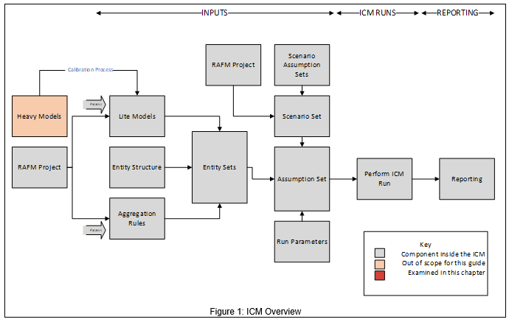
Solvency and ICM Overview
The design of the ICM was initially prompted by the Solvency II directive, which was a fundamental change in the solvency framework for European insurance groups. The ICM has from that time been run with two calibrations, being Solvency II and Economic Capital (ECap). In 2021 the Group Internal Capital Assessment (GIECA) replaced the ECAP metric. Going forward GIECA will become the single metric of the Group.
The key output of the ICM on a day-to-day basis is therefore the Economic Capital Requirement (ECR) at both GHO and BU levels.
The ICM includes models used to calculate assets, technical provisions, risk margin and capital requirements, and is used to calculate the following (not an exhaustive list):
Group and solo ECRs;
“What If” impact analysis on the ECR;
Risk margin;
Approximate assets, technical provisions and ECR on a “live” basis for continual solvency monitoring and for “What If” analysis;
Projection of the balance sheet for up to 3 years in advance; and
Profit and loss attribution – both Own Funds and /Available Economic Capital.

Slide 10
Key components
Lite Models
The term “lite model” refers to the methodology that is used for the rapid calculation of the value of assets and liabilities for each product line under a large number of stochastic simulations (risk driver simulations over one year).
The methodology aims to optimise the trade-off between speed of calculation and accuracy and therefore different approaches are used for different business areas in order to maximise the overall effectiveness of the internal model.
Simulations
The term “risk driver” refers to the development of 1 year real-world probability distributions for each of the risks modelled within the ICM (economic and non-economic), allowing for the dependencies between risk factors.
BUs define the risk drivers for non-market risks in each local entity together with associated dependency structures; Group Finance defines the risk drivers for market risks together with the dependency structures across different territories.
The risk driver information above is entered into the Risk Scenario Generator (“RSG”) calculation tool and it produces a RSG file containing a maximum number (such as 100,000) of risk scenarios for the base balance sheet run. These risk scenarios, when combined with the lite models above and asset portfolios (as appropriate) in the calculation engine (see below), provide the value of assets and liabilities for each of the 100,000 risk scenarios, which in turn gives the required capital for each risk scenario.
Various RSG files are also produced by GHO for the purposes of projecting the balance sheet, profit and loss attribution and “What If” scenarios. The production of some of these RSG files requires certain information which is provided to GHO by the BUs.

Slide 11
Key components (Contd.,)
Entity structure and Aggregation Rules
This refers to the way in which risks and legal entities are defined and consolidated within the ICM, including the definition of the legal entities and product groupings, and the resulting capital fungibility.
BUs will define the aggregation structure for all products within their territories; Group Finance will define the aggregation structure between BUs.
Calculation engine
The calculation engine applies the lite models under a large number of simulations of the risk drivers, to calculate aggregate assets and liabilities in each simulation.
The assets and liabilities for each entity in each simulation are aggregated using the aggregation rules across the Entity Structure, allowing for fungibility of capital / entity structure and allowing for group level cashflows (such as group tax which depend on aggregated asset / liability values).
Calculation of the aggregated assets and liabilities in each simulation gives a full stochastic distribution of balance sheets, from which the ECR can be determined (using the 99.5% of the distribution).
The calculation engine is designed to perform these calculations very quickly to allow a large number of simulations to be carried out in every run (e.g. it is expected that a typical run of the model would involve up to 100,000 simulations to enable a 99.5th percentile to be calculated).
The calculation engine also calculates the appropriate allocation of economic capital back to underlying risk drivers and legal entities in order to allocate total group-wide diversification benefits. The ICM calculation engine is Risk Agility FM (RAFM), a software offering from Willis Towers Watson.

Slide 12
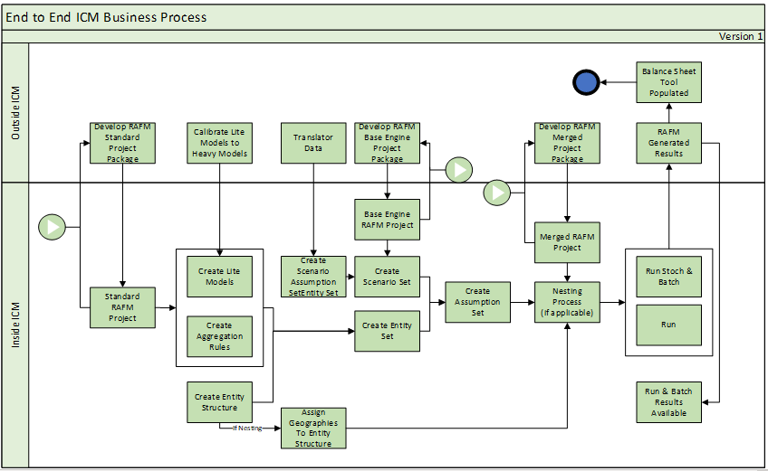
Business Process
The process model below depicts the end to end process enacted by the reporting teams in any given reporting cycle.

Slide 13
Key contextual information - RAFM
What is a RAFM project?
ICM RAFM Projects are developed locally within the RAFM application. Development allows a user to write modelling code, set parameters, define model runs with the aim of producing specific output. RAFM projects must be imported into ICM before being associated with other ICM components such as lite models, aggregation rules and scenario sets.
The ICM RAFM project on the ICM enable RAFM project storage and versioning of the code base used by the RAFM application when processing an ICM run.
The RAFM projects are categorised into three ICM RAFM project types:
Base engine project (only specific GHO users can create and share this type)
Standard ICM RAFM project
Merged ICM RAFM project (only specific GHO users can assign this type)
Business Context
An ICM RAFM project holds all project files, executable files and code files. The code files are also known as code bases. The various types of code bases are: Lite model;
Aggregation rule;
Bridge aggregators;
RSG; and
API.
Code bases are developed in the RAFM application and along with executable files are imported into the ICM prior to being associated with other ICM components and run as part of an assumption set. When a change is required to the code bases, the ICM RAFM projects can be downloaded from the ICM and imported into the RAFM application prior to making development updates. Post development, updated ICM RAFM projects are imported back into the ICM as a complete RAFM project package (.zip file format).
As changes occur in the conceptual business model, these projects will change and will need to be updated. The examples below illustrate some of the reasons why the business may need to update ICM RAFM projects to reflect changes in the project code base:
Where development changes are required in the lite model and aggregation rule code to reflect business requirements;
Where risk models usage has changed;
Where a change is required to reflect updated scenario data requirements, such as a change in the risk driver universe.

Slide 14
Key contextual information - RSG
What are Risk Scenario Generator (RSG) scenario sets?
The RSG engine produces a set of future possible scenarios for all the risk drivers across the group (e.g. market risk drivers, insurance risk drivers and operational risk drivers). The RSG scenario production process requires the key inputs to be agreed between GHO and the BU teams before the GHO-RSG operations team can commence work to produce the scenario data.
The ICM interface allows users to create scenario sets for use within the ICM to calculate results for various capital metrics, using a base engine project and the RSG engine. The RSG engine can be used to produce various types of scenario sets which include GIECA scenarios, stress scenario packs, manual testing scenarios and other ad-hoc analysis scenarios.
Business Context
Scenario sets are based on the different risk drivers a business faces and are assigned to assumption sets to produce results. The scenarios capture the state of each of the risks depending on the distributions used to model them. By capturing these scenarios in scenario sets it is possible to use the ICM system to swap groups of scenarios to produce results for different purposes. The risk drivers feeding into a group risk profile may change over time which will also give rise to a requirement for the Group to create new scenario sets to be used to produce results. The examples below illustrate some of the reasons why the business may need to create new scenario sets:
Use of an additional risk driver: Businesses may wish to model additional risk drivers in their Lite Models and would therefore need to create new scenario files to incorporate these as well as the RSG files required for each of the P&L steps
Reflect new ways of risk modelling and methodology specifications
For the purposes of performing various “What If?” stresses e.g. an equity market of 40% from the base scenario
When the scenario calibration inputs have changed
When a scenario set needs to be associated with a different base engine

Slide 15
Key contextual information – Lite Models
What is a lite model?
A lite model (LM) is a simplified valuation tool for rapid calculation of assets and liabilities in a given simulation, with projection capability, specified by business units consistent with group standards. Through a process of calibration, lite models are created to replicate heavy model output under a range of different conditions. It involves running the heavy models under different scenarios and setting up lite model parameters and C++ code to fit the output.
Lite models are a key input to the ICM interface and RAFM application, and are maintained by business units. They may be adapted over time to reflect improved modelling approaches, changes in legislation or use, and changed demographics/markets. Changes to lite models are made in the RAFM development application. The ICM interface does not have the facility to change lite model code.
Business Context
Lite models are representations of homogenous groupings of a business’ assets and liabilities and can produce quick re-calculations of the asset and liability positions based on changes to the risks to which the business is exposed. The illustrative examples provided below provide examples of when businesses may work with lite models and update its key components in the RAFM development application:
New line of business - create a new lite model
Where groups of business have similar risk profiles, they are often grouped together within a lite model. A new line of business (e.g. new product launch) may not necessarily have the same risk profile as the existing lines of business, in which case it would not fit under the existing lite model and would give rise to the need to create a new lite model.
Change in risk profile – recalibrate a lite model
Lite models are calibrated to replicate the results produced by heavy models under a range of different scenarios. When the heavy model results change due to, for example, changes in economic conditions it is necessary to recalibrate the lite models. A change in the risk exposure may require a lite model to be updated through a process of recalibration (updating of the coefficients associated with a particular lite model formula).

Slide 16
Key contextual information – Lite Models
Business Context – Lite Models (contd.,)
Process timing – true-up of a lite model
Often businesses may re-calibrate a lite model a couple of months before a year-end exercise due to the time required for the calibration processes. It may be necessary to perform a ‘true-up’ process to reflect changes in the risk exposure between the re-calibration date and the year-end valuation date. Typically, this would be done by the use ‘true-up’ factors which scale the results of the lite models to the results produced by Heavy models under defined stress scenarios. The ‘true-up’ factors are stored in a specific tab of the experience parameters file associated with a lite model.
Extraordinary experience in a particular month – recalibrate or ‘true-up’ a lite model
Significant unexpected or external changes may lead to a change in the demographic risk profile for lite models - for instance, a lapse shock or a sudden increase in new business volumes. These change the in-force volume during a year and, rather than recalibrating or performing a true-up, experience parameters can be adjusted to reflect this change. This would lead to a revised experience parameters workbook which would be used thereafter until the next recalibration.
Year-end P&L results – update lite model’s experience parameters
The experience parameters associated with a lite model reflect both actual historical experience (used for a P&L attribution exercise) and expected future experience (used for a projection calculation run). Depending on the purpose of the calculation run, one or both sets of experience parameters will need to be updated by businesses.
Change in business profile - recode lite model
A change in the business profile (typically over a number of years) may give rise to a need to re-assess the risk profile reflected within a lite model in a more fundamental way than performing a re-calibration process. This re-assessment may involve the addition of new risk drivers and / or the removal of existing risk drivers. This would require the lite model to be recoded, which would involve re-creating the formula within the lite model and establishing the appropriate coefficients so that the lite model represents the results of the heavy model under defined stresses.

Slide 17
Key contextual information – Entity Structure
What is an entity structure
An entity structure is a mechanism for tying different lite models and aggregation rules together as a set of parent-child relationships. The interface allows entity structures to be broken up into layers for different parts of the business to specify and maintain their own sections as appropriate. Ultimately, the entity structure should link up all the lite models at leaf nodes and aggregation rules at non-leaf nodes and combine them into the group structure. This is all done through the entity set management interface.
Entity structures can be created offline, with respect to the ICM interface, or from within the interface. An entity structure has a geographical user group and is used in assumption sets to help organise the other modelling components.
Responsibility for maintaining the entity structure falls to different parts of the group – i.e. GHO is responsible for the overall group structure, RHOs for their own local sub-structure, and local BUs for their own local structure.
Business Context
Defining the entity structure to be modelled is the start of the process to calculate capital requirements through the ICM. The entity structure describes the relationship between lite models and Aggregation Rules and forms a view of how the business is modelled.
The illustrative examples provided below describe typical situations where businesses may have to change their entity structures:
Addition or removal of a lite models as a result of re-structuring or mergers and acquisitions activity;
Investigative work to understand the capital implications of proposed mergers and acquisitions activity;
Investigative work to understand the capital implications of possible entity structures;
Dividing a lite model into two lite models due to more granular modelling of risk profiles; and
Combining two lite models into a single lite model due to modelling simplification work.

Slide 18
Key contextual information – Aggregation Rules
What are aggregation rules?
Aggregation rules are the means of “summing up” and modifying asset, liability and capital figures as they flow up the entity structure. Each non-leaf node in the entity structure will have an aggregation rule associated with it (even if it is a simple “sum-of-children” rule) to define how capital metrics from child entities (including lite models at the leaf nodes of the entity structure tree) are combined. Many nodes will use simple “sum-of-children” functionality; others will be more complex.
An aggregation rule consists of an aggregation rule code base and a parameter file, both of which are associated with the same Standard ICM RAFM project. Over time, some aggregation rules will evolve and multiple versions will be created. As any component is updated, the version number will change so that any given run of the ICM records the exact version run in its manifest file
Business Context
As mentioned above, aggregation rules combine the results of different lite models and/or other lower aggregation rules and are the means of “summing up” and modifying asset, liability and capital figures as they flow up the entity structure. The illustrative examples provided below describe typical situations where businesses, in the face of evolving circumstances, may need to change their aggregation rules:
Aggregation rules are a fundamental part of entity structures, and therefore, there are likely to be changes to aggregation rules to reflect the illustrative changes to entity structures. Whenever an entity structure changes to include/exclude aggregation rule nodes, businesses will need to update their aggregation rules accordingly.
Changes in tax treatment and deferred tax recoverability caps; and
New intra-group transactions.

Slide 19
Key contextual information – Entity Set
What is an entity set?
Entity sets are groups of lite models and aggregation rules attached to an entity structure. Their primary purpose is to facilitate the re-use of sets of lite models and aggregation rules in different assumption sets in the ICM. They also allow for rapid validation of lite models and aggregation rules through their own validation.
The smallest possible entity set is a single node of an entity structure with a single lite model attached to it; the largest possible entity set is the whole group, with all aggregation rules and lite models. When an entity set is associated with a scenario set through an assumption set, it can then be run with relevant run parameters to suit the purpose of the run type.
Business Context
The entity set is solely an ICM interface concept and is a collection of ICM components including an entity structure, lite models and aggregation rules.
Please note: ICM RAFM projects are associated at the lite model/aggregation rule/scenario set not an entity set.
The entity set is an essential component of an assumption set along with a scenario set and run parameters. When the assumption set is run in the ICM it will produce the various capital metrics for reporting purposes

Slide 20
Key contextual information – Assumption Set
What is an assumption set?
Assumption sets are groups of modelling components that are the minimum construct that can be run into RAFM within the ICM.
An assumption set consists of the following components:
an entity set with attached lite models and aggregation rules on at least all the nodes up to the highest node from which the run is to be triggered;
a scenario set;
RAFM projects that are associated with lite models, aggregation rules and scenario set;
a set of run parameters; and
a set of experience parameters.
An assumption set run can be run in ICM using RAFM technology as a calculation engine and processed over vGrid.
Development of projects, lite models and aggregation rules is conducted in the RAFM application directly without using the ICM interface.
Before an assumption set can be run, the associated components must pass lite model/aggregation rule and RSG compliance. Compliance indicators are provided and are located in the ‘Validation Panel for’ pane in the lower right hand side of the assumption sets summary table screen

Slide 21
Thank you

